Slide 1
Displaced Voices
Using Data Science Tools for Housing Justice

Slide 2

Project Objectives
Primary Goal: Forecast eviction numbers for 2025 to enable proactive budgeting
Target: Assist Arizona government in allocating rental assistance funds efficiently
Approach: Three-pronged analysis using 2022-2024 eviction data
Impact: Ensure no household is left behind due to funding shortfalls
Find other photo options

Slide 3
Track Members
Visualization Track
Members: Nhi Nguyen, Devang Singhal
Statistical analysis Track
Members: Sean Skinner, Leticia Favero Lopes
Predictive Modeling Track
Members: Sai Roy, Harshini Balamurugan Vadivazhagi,
Rati Tabatadze, Poojitha Nuthalapati, Tylor Vongsenekeo

Slide 4
How each track helps with the project
1
2
3
Visualization Analysis - Exploratory data insights through visual patterns
Statistical Analysis - Identifying key drivers of eviction risk
Predictive Modeling - Time series forecasting for 2025

Slide 5
Visualization track
Nhi Nguyen, Devang Singhal

Slide 6
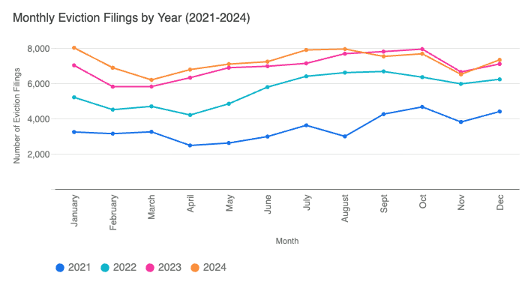
Eviction Filings (2021 - 2024)
Find other photo options

Slide 7
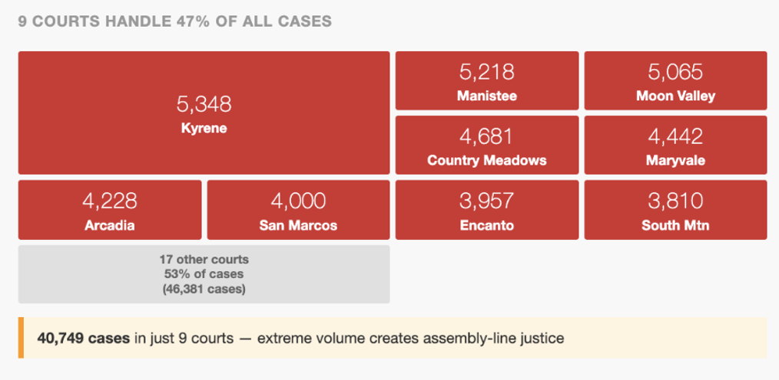
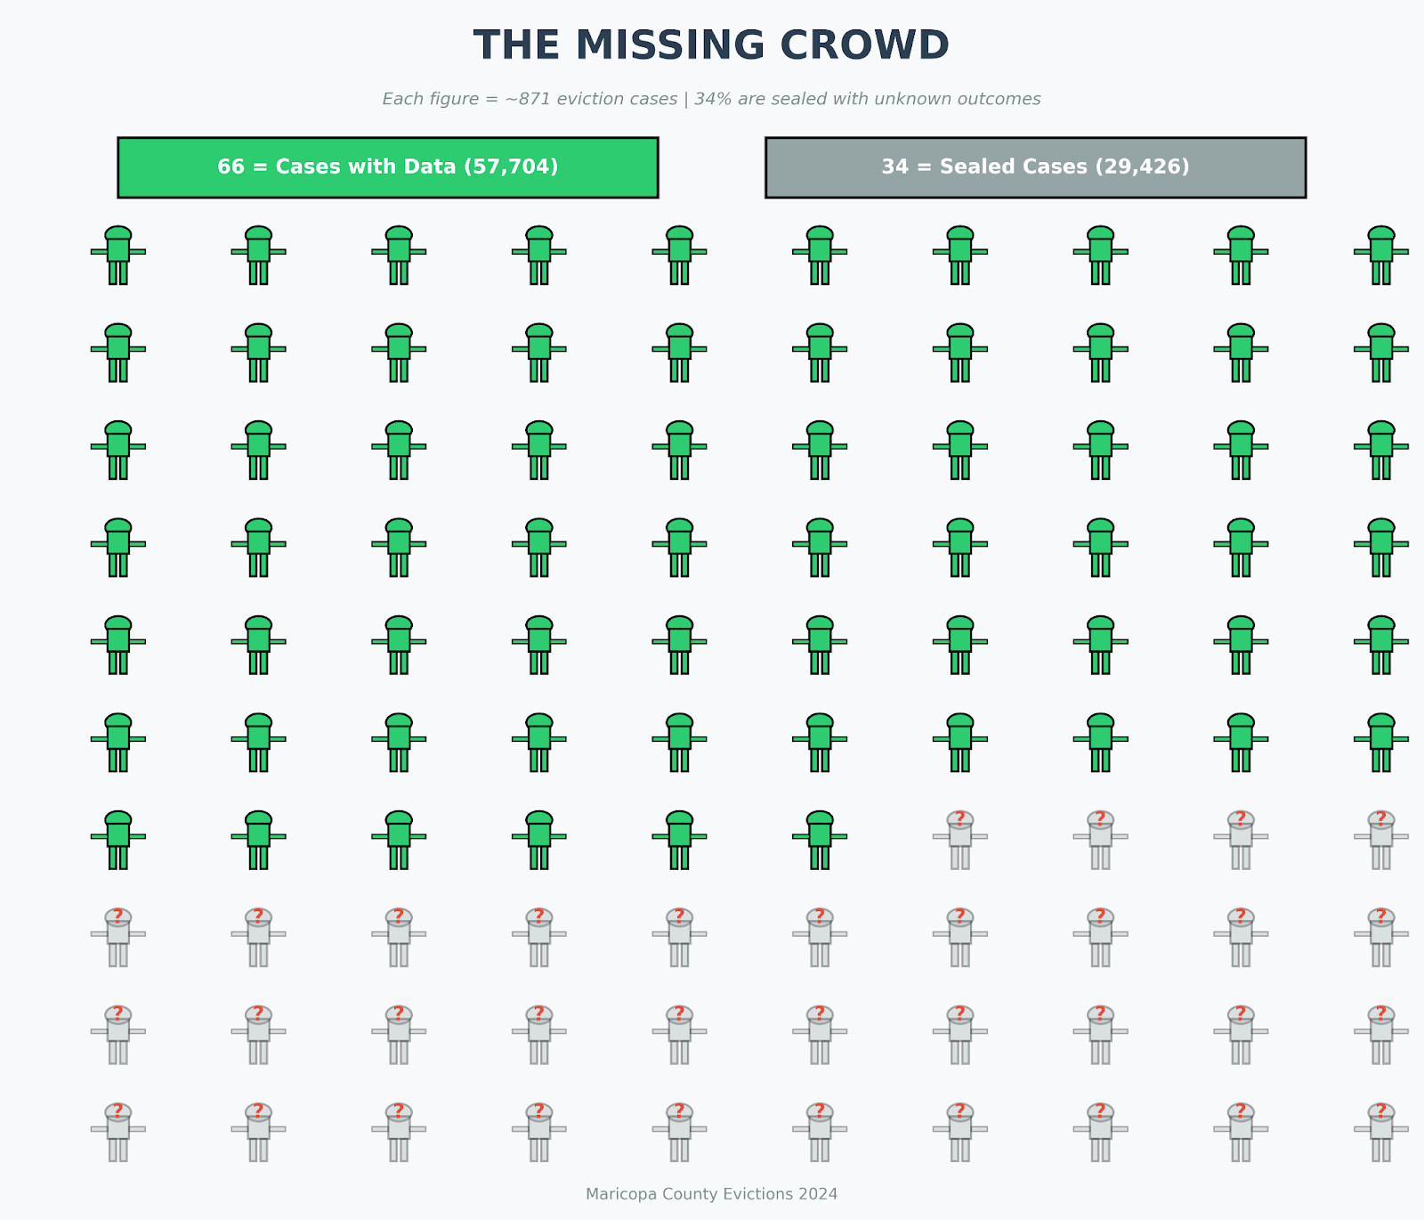
The Cases With Data and Sealed Cases
Find other photo options

Slide 8
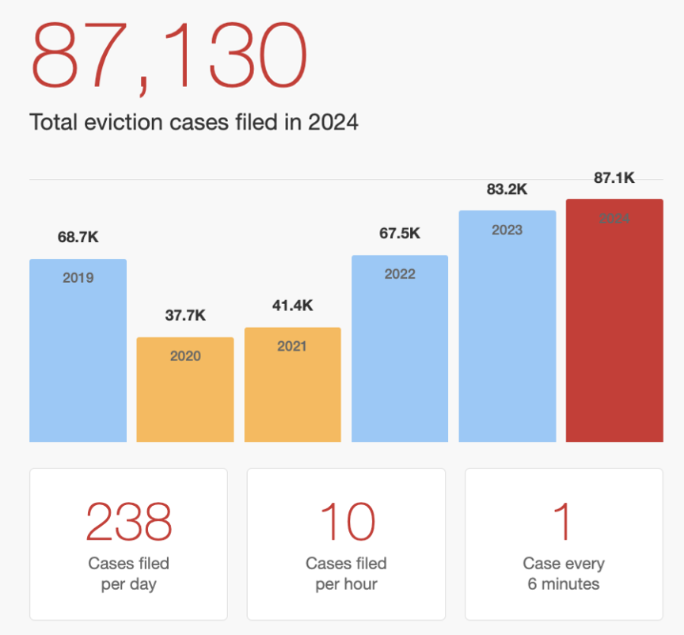
Courts process: Legal representation and Cases filed
94.2 % of landlords had legal representation.
99.8 % of tenants did not have legal representation.
Find other photo options

Slide 9
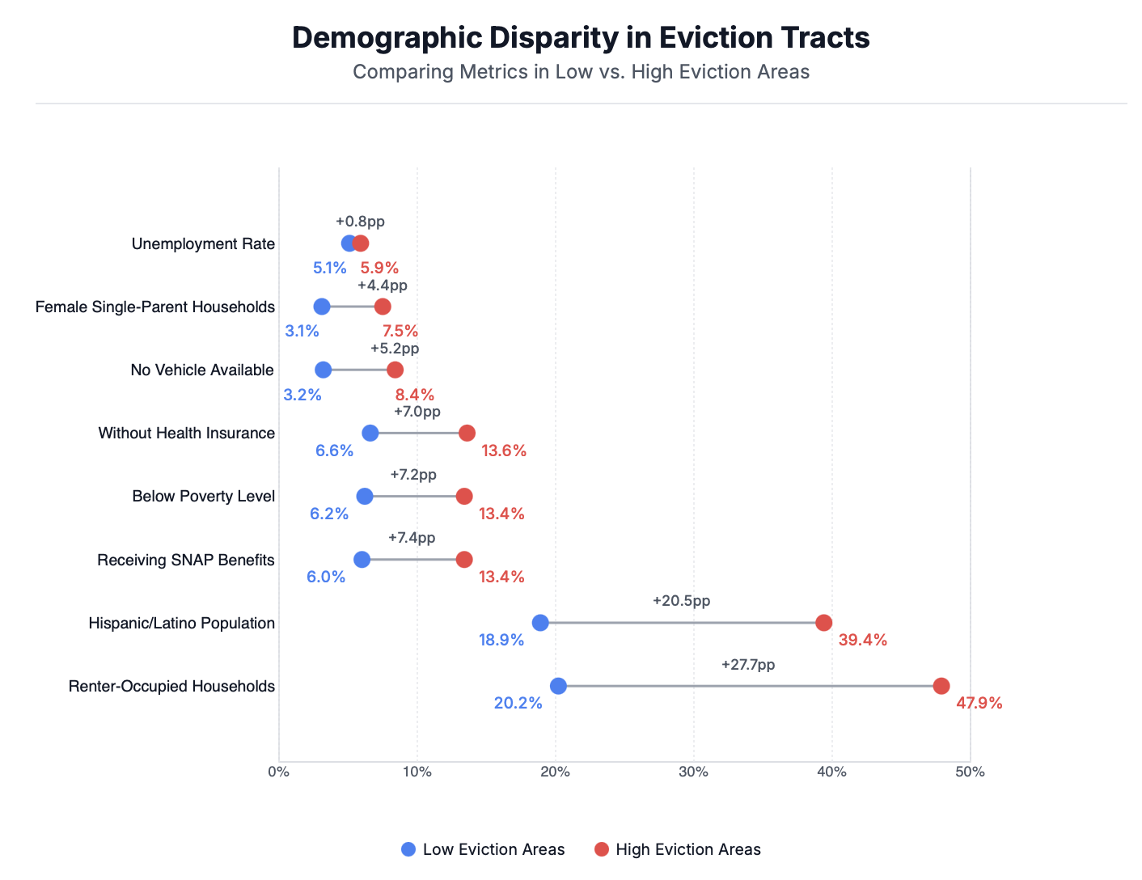
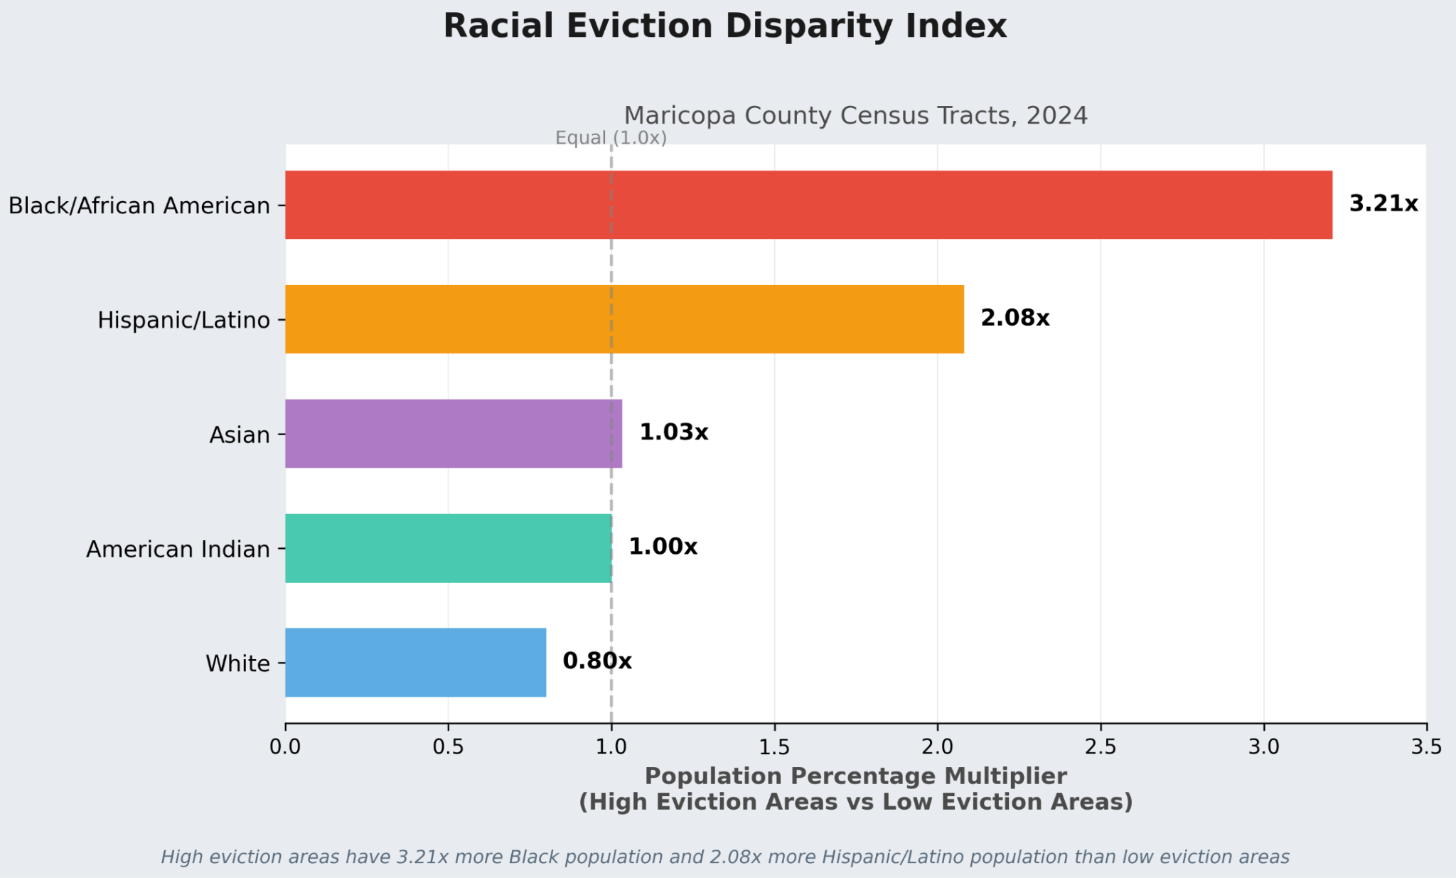
Demographics of the tenants

Slide 10
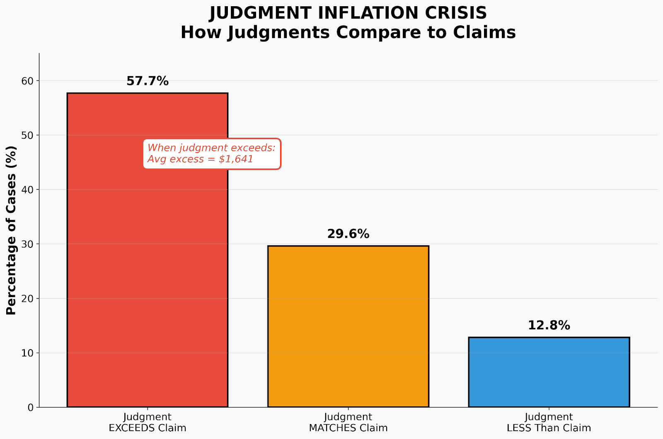
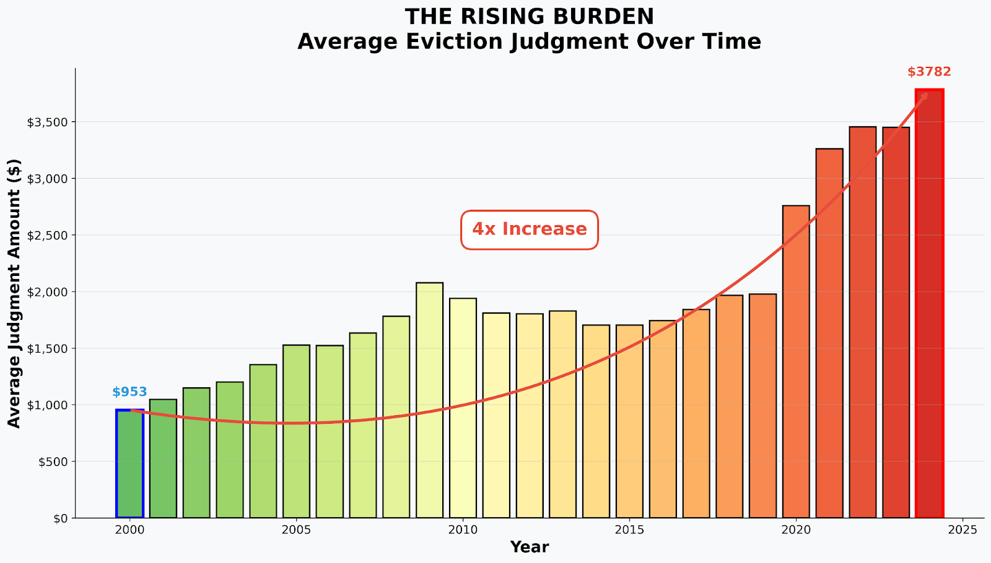
The monetary burden of eviction cases

Slide 11
Statistical Analysis track
Sean Skinner, Leticia Favero Lopes

Slide 12
Initial Factors
Dependent Variable: Eviction Rate
Independent Variables: Income and
Demographics:
Median Income, Median Monthly Cost, Median Gross Rent
Racial Percentages
Single Male Parent, Single Female Parent, Disability, Below Poverty Line Percentages
Find other photo options

Slide 13
First Steps
Cleaned data to account for missing values
Removed outlier
One region had an eviction rate over ten times the next highest (ZIP code 85008, near Papago Park)
Generated linear regression, analyzed multicollinearity
Find other photo options
Notes:
The mentioned zip code has a high amount of renters and low median income

Slide 14
Iterative Regression
Removed ethnic demographic variables due to high levels of multicollinearity
Performed log transformations on dependent and some independent variables for goodness-of-fit
Iterated through until best fit found
Find other photo options

Slide 15
Final Regression
Most Statistically Significant Term: Percentage of Single Female Parent Households
Interpretation: an increase of 1 percentage point in single female parent households corresponds to an increase in the eviction rate by a factor of approximately 5%
Other variables included:
Median Rent (logarithm)
Median Income (logarithm)
Percentage Below Poverty Level
Percentage of Single Male Parent Households
Percentage Not US Citizen
Median Monthly Housing Cost
Find other photo options

Slide 16
Predictive Modeling
Sai Roy, Sudamshu Rao, Harshini Balamurugan Vadivazhagi,
Rati Tabatadze, Poojitha Nuthalapati, Tylor Vongsenekeo

Slide 17
Our Prediction Strategy
The Method: Learning from the past to predict the future
The Data: Three years of Maricopa County eviction records (2022-2024)
The Goal: Forecast monthly evictions throughout 2025
The Benefit: Helps Arizona plan and budget before families are in crisis
Find other photo options

Slide 18
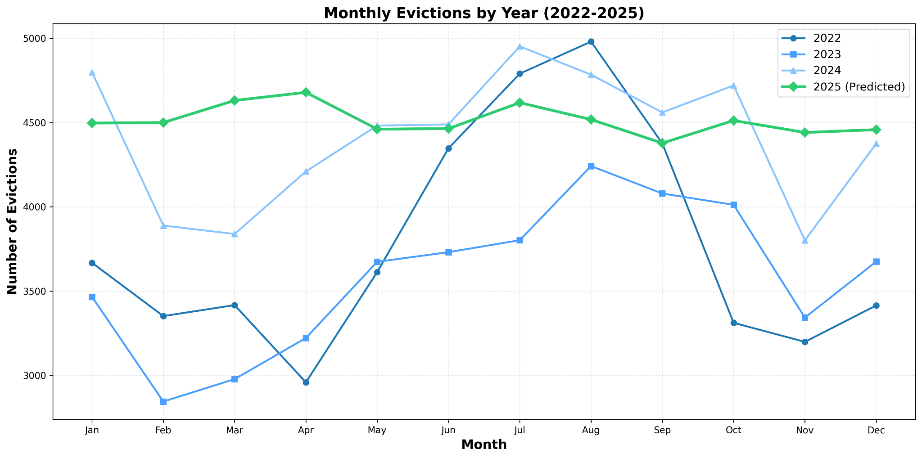
Time Series Graph
Find other photo options

Slide 19
Dataset
Using sealed records from 2022–2024 to predict eviction rates for 2025.
Year | Total Records | Average per Month
2022 | 45,428 | 3,785
2023 | 43,069 | 3,589
2024 | 52,900 | 4,408
2025 (Predicted) | 54,143 | 4,513
Find other photo options

Slide 20
What the data says
Key Takeaways:
16% increase from 2022 to 2024 - trend continues into 2025
Summer months (July-August) consistently highest risk across all years
2025 prediction: 54,143 evictions - highest year yet
Monthly average rising: From 3,785 (2022) to 4,513 (2025)
Intervention window: Spring months show early warning signs before summer peaks
Find other photo options

Slide 21
Compare with the 2025 actual evictions data
Current Statistics
Month | Evictions
January | 7,613
February | 7,070
March | 5,996
April | 6,788
May | 7,101
June | 7,029
July | 7,250
August | 7,565
September | 7,310
Prediction Results
Month | Prediction
January | 4,497
February | 4,500
March | 4,631
April | 4,679
May | 4,461
June | 4,464
July | 4,618
August | 4,518
September | 4,378

Slide 22
Moving Forward
Current Limitations:
Data Scope: Analysis limited to unsealed eviction records; sealed cases not captured in dataset
Variable Coverage: Model focuses on temporal patterns; additional socioeconomic factors could enhance accuracy
Geographic Granularity: County level analysis; census tract detail would enable targeted interventions
Future Enhancements:
Expanded Data Integration: Incorporate datasets like the labor statistics and american community survey data
Advanced Modeling: Deploy neural networks to discover complex cross dataset relationships

Slide 23
Conclusion
UDS Displaced Voices
These predictions aren't just numbers, they're real individuals needing support and each statistic represents families, children, and communities we can protect.

Slide 24


